Slide 1
From the Triangle Room To CARIBU:
The status of r-process mass measurements with the CPT
Daniel Lascar
ANL Physics Division
November Student Lunch Meeting
November 17, 2010

Slide 2
The Order of Things
Physical Motivations
The CPT
CARIBU
The Move to CARIBU
The New Campaign

Slide 3
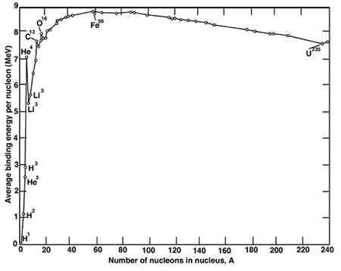
Nucleosynthesis of the Heavy Elements.
Energy Released
Energy Absorbed
Krane

Slide 4
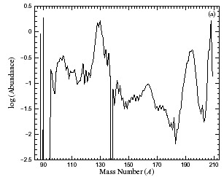
We Know Some Things From Elemental Abundances
A | N
195 | 126
130 | 82
80* | 50*
[Quian ‘03]
* Not Shown

Slide 5
We Begin With Some Sort of Explosion
This is an epoch in a star’s life where:
Temperatures are very high (T~10⁹K)
Neutron densities are very high (n_{n}>10²⁰ cm⁻³)
(n,γ) rate increases rapidly for stable nuclei (~0.2 μs)
Buildup of higher A nuclei possible very rapidly.
ANYTHING GOES! NEUTRONS GONE WILD!
…
Z
N
11/17/2010

Slide 6
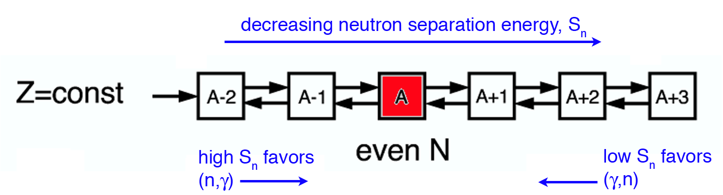
Well…There are a few constraints (γ,n) is also going on
[Champagne RIASS06]
The neutron separation energy at equilibrium (S⁰_{n}) decreases with higher N
11/17/2010

Slide 7
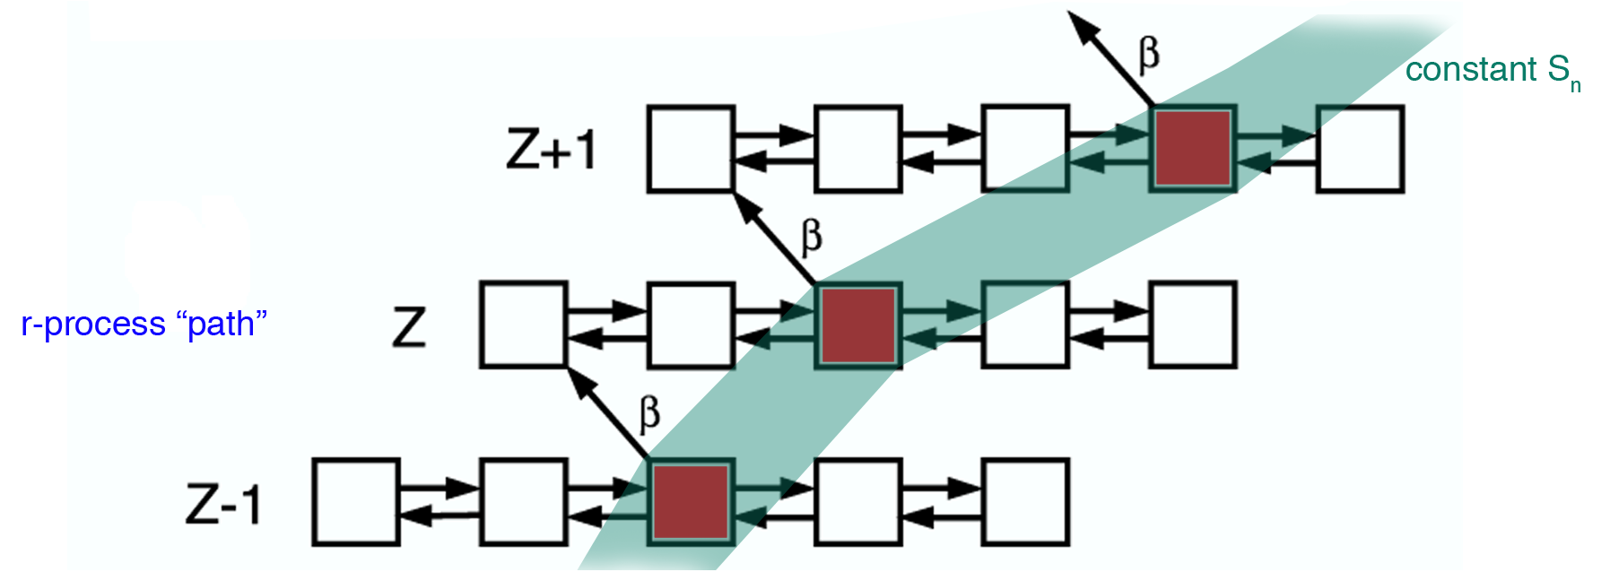
So we wait for a β-decay
[Champagne RIASS06]
The S_{n} where equilibrium occurs depends only on T and n_{n}
11/17/2010

Slide 8
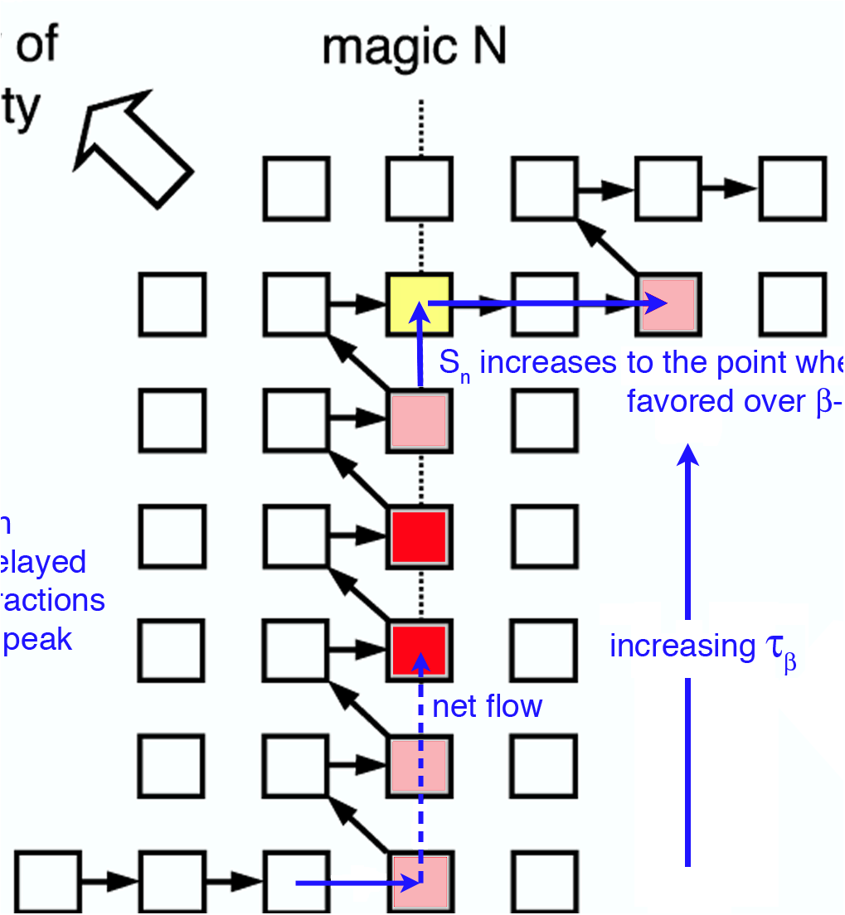
Shell Closures: N=50, 82, 126 Other Waiting points
[Champagne RIASS06]
11/17/2010

Slide 9
J. Van Schelt 2010

Slide 10
J. Van Schelt 2010

Slide 11
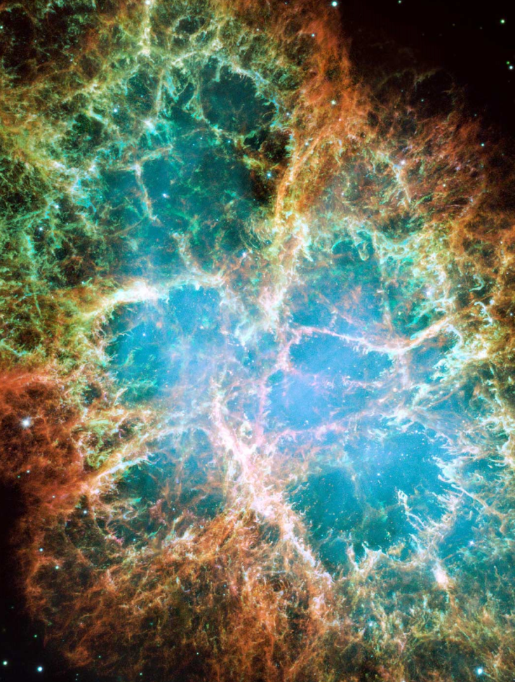
It’s an Explosion!
Time is of the essence
High Temperature is rapidly decreasing.
High n_{n} also rapidly decreasing.
The entire process take ~2-3 s
(n,γ) occurs ~μs
β-decay occurs ~ms
11/17/2010

Slide 12
Creation of the elements
s process
Mass known
Pb (82)
Half-life known
nothing known
p process
r process
Sn (50)
rp process
Fe (26)
Supernovae
r-process proceeds almost entirely in the unexplored region of the nuclear landscape
stellar burning
Cosmic Rays
protons
H(1)
G. Savard
neutrons
Big Bang

Slide 13
Play r-process movie

Slide 14
So What Can We Do?
CRITICAL
Probably known
KNOWN
LET’S FIND OUT

Slide 15
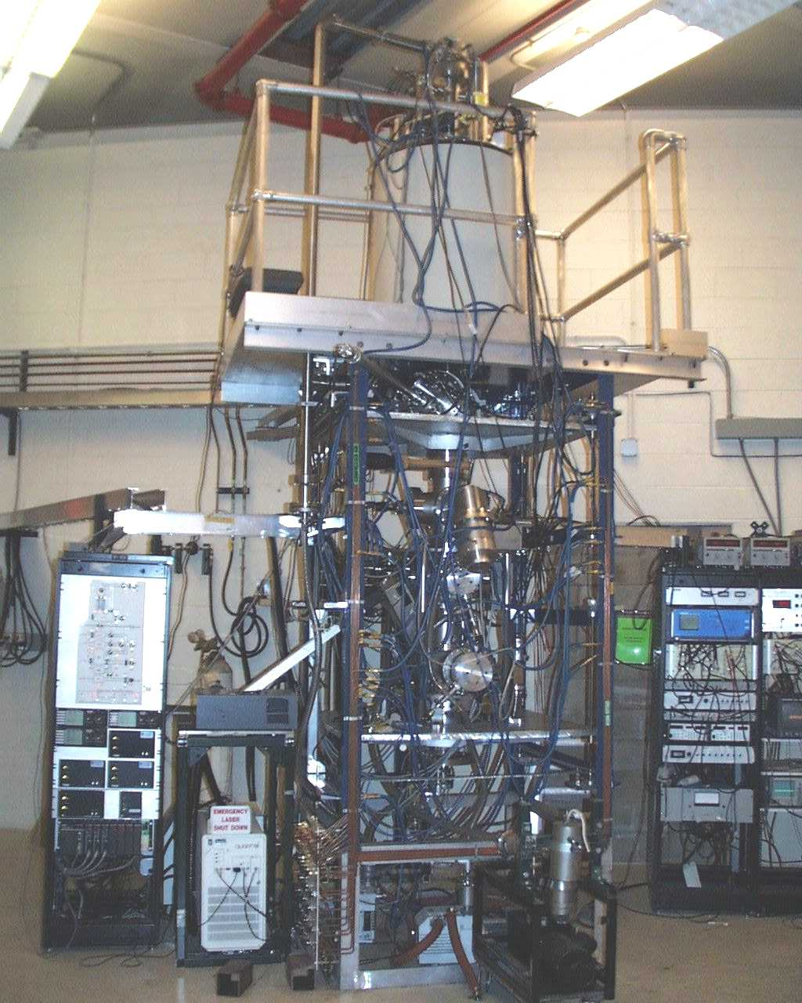
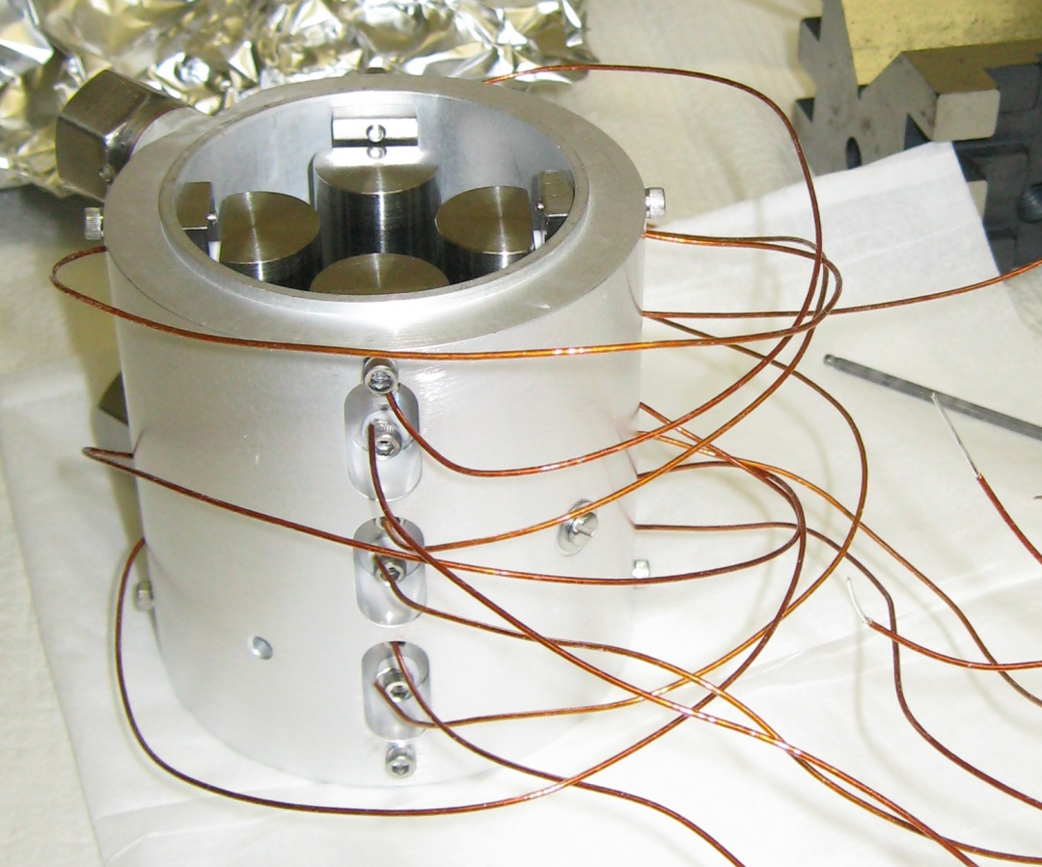
RFQ Paul Trap below Penning Trap
Cools multiple bunches
Removes information from source.
Currently modifying to allow for LN₂ Cooling
Smaller Bunch
Low Energy Spread

Slide 16
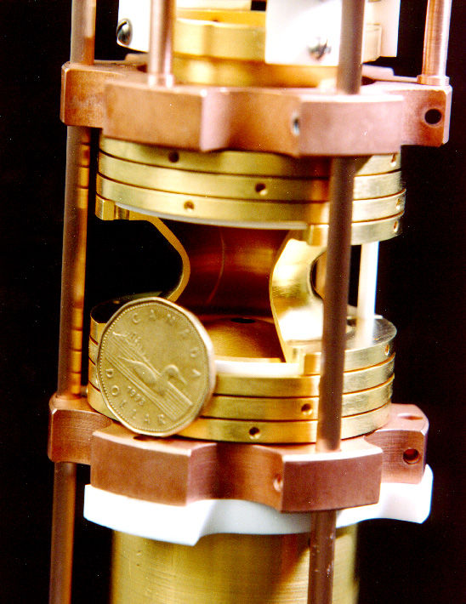
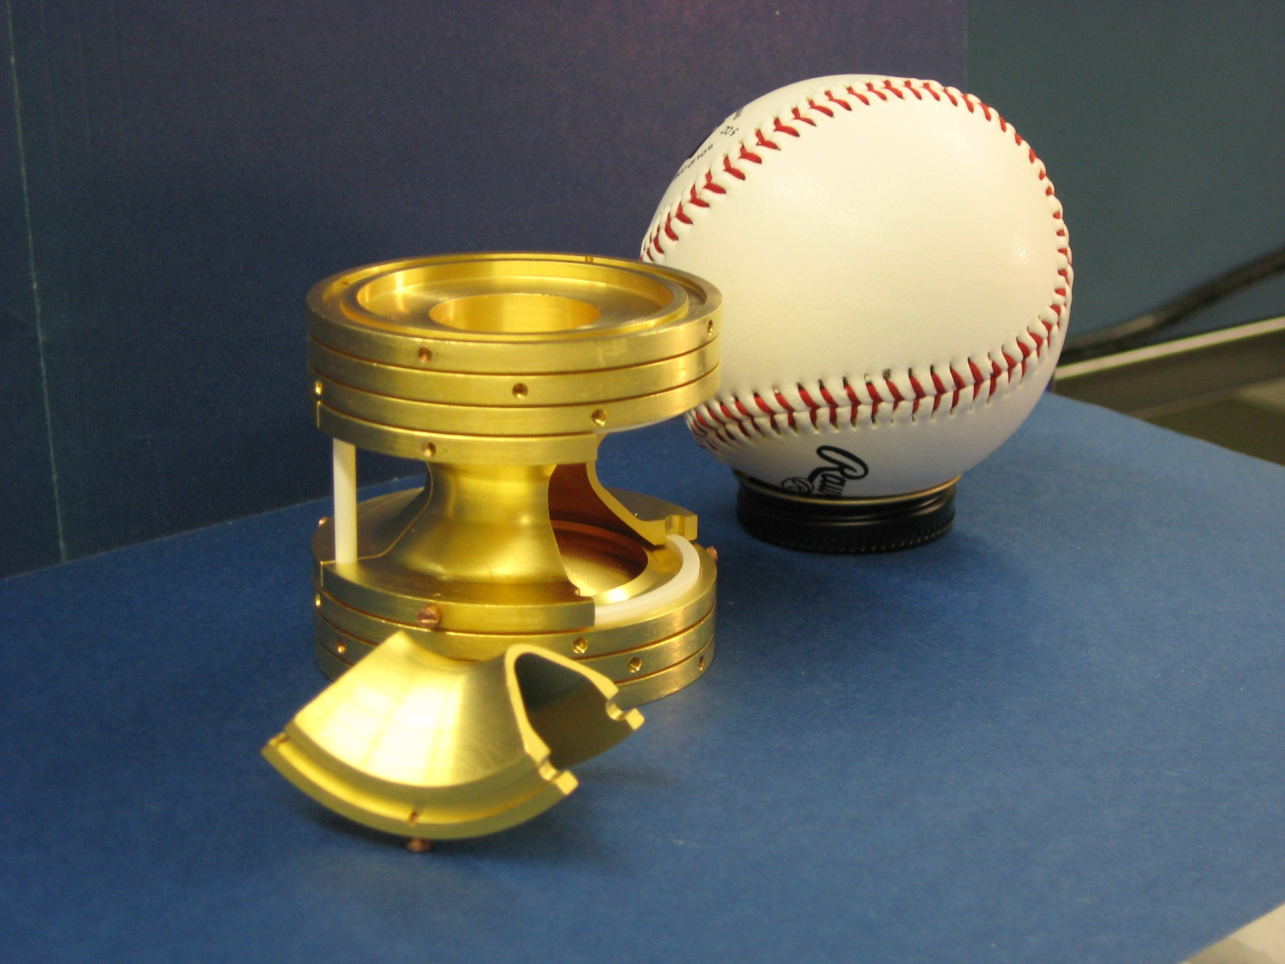
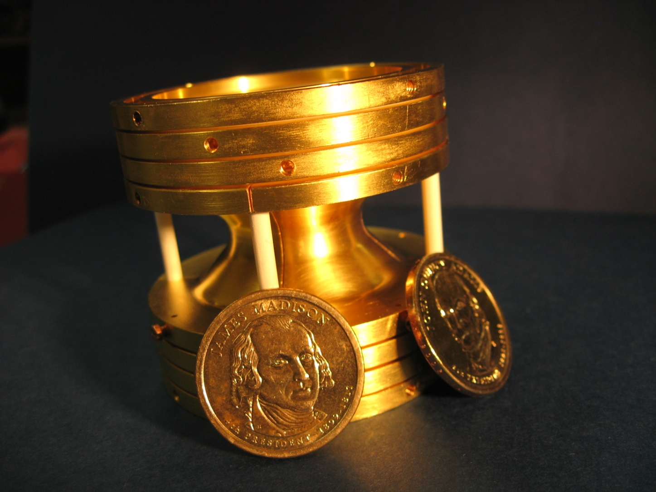
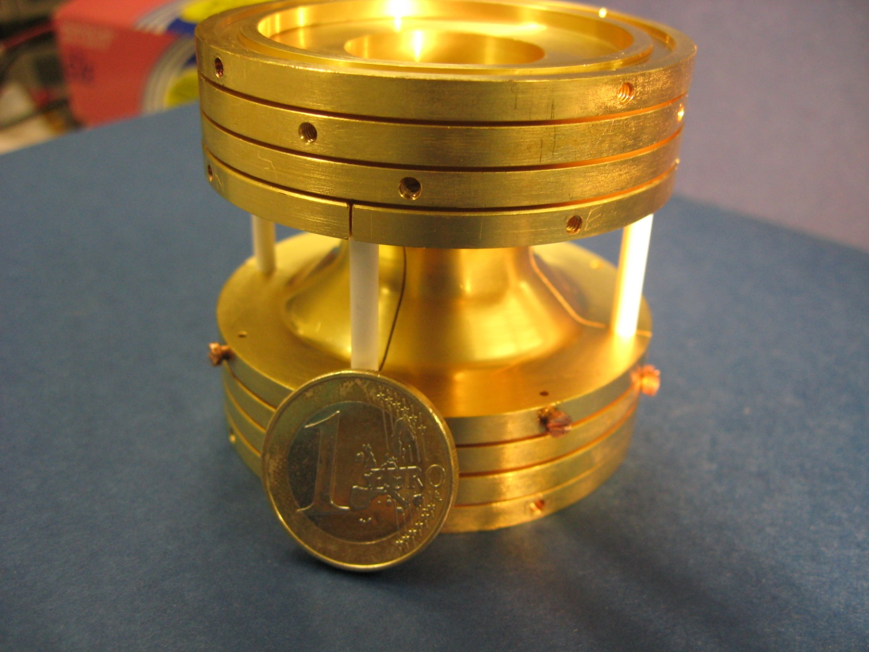
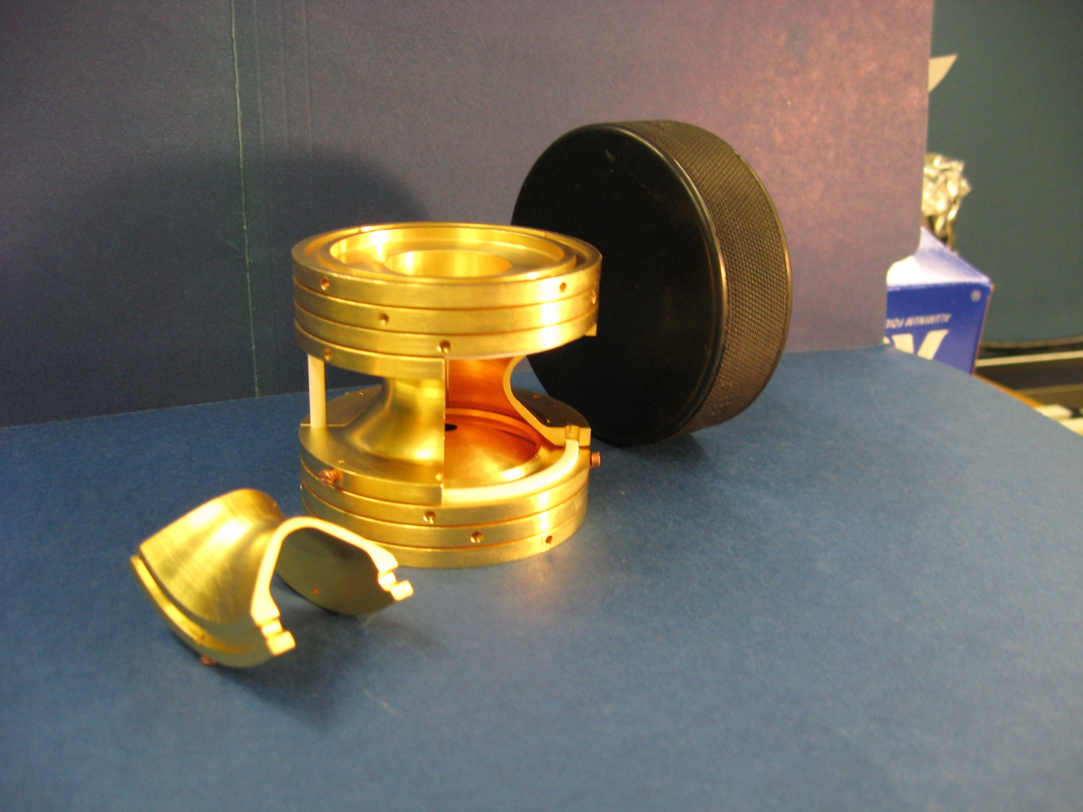
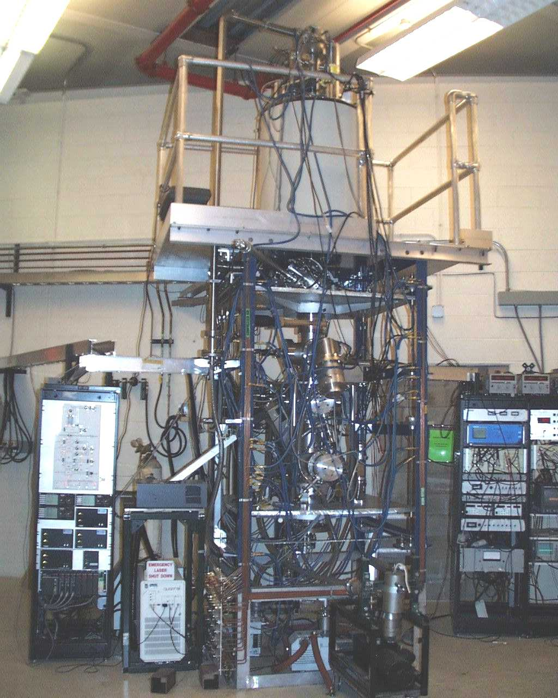
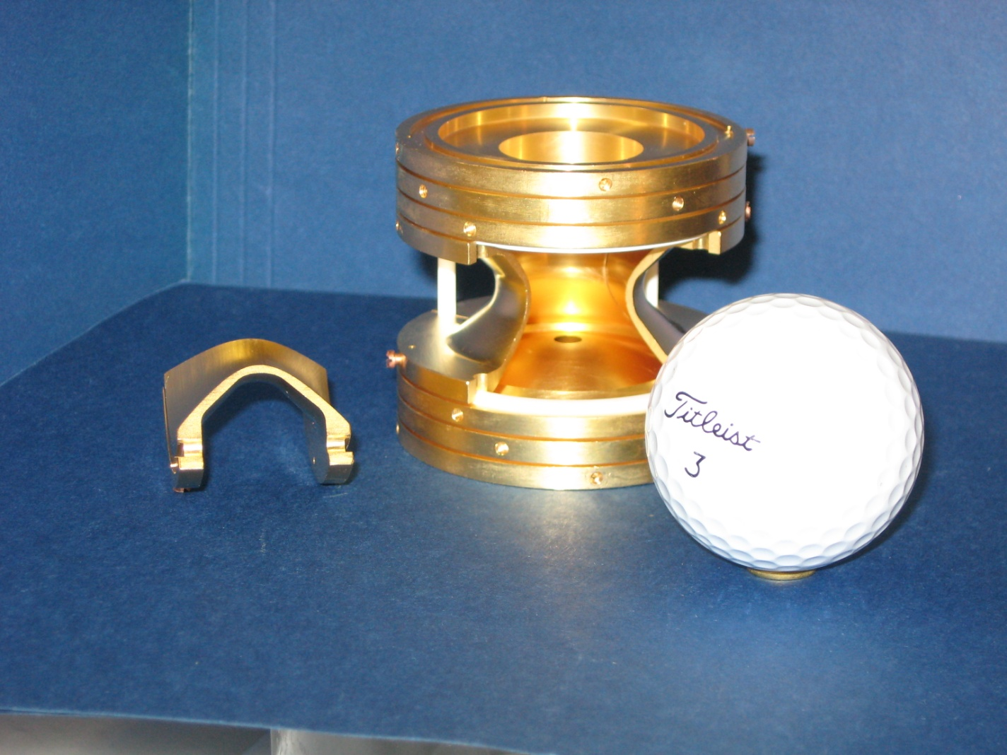
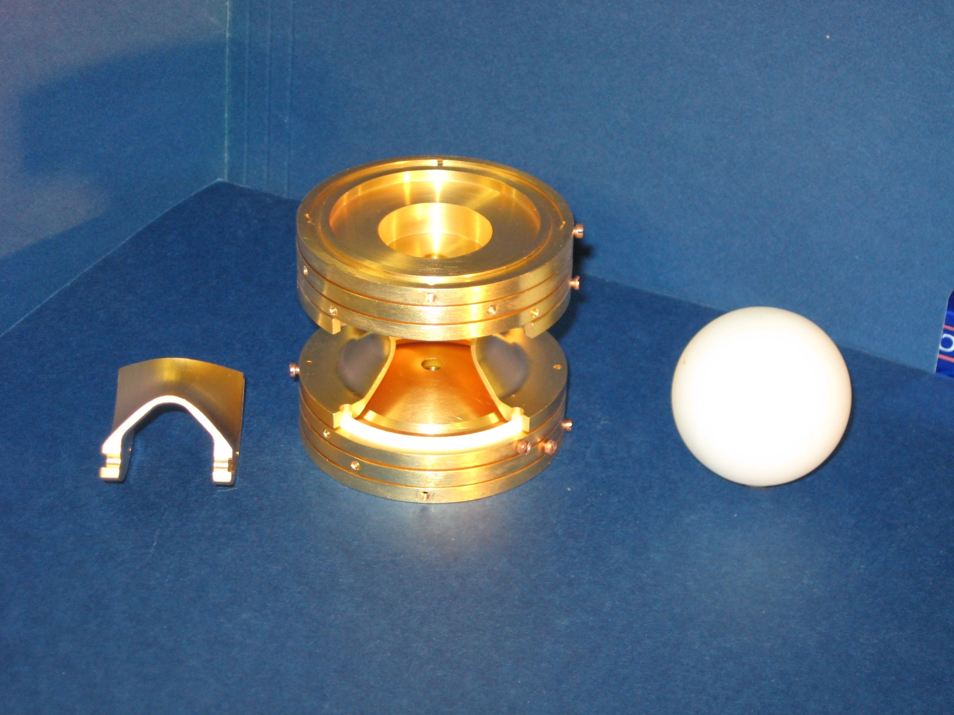
The Magic of the CPT
11/17/2010

Slide 17
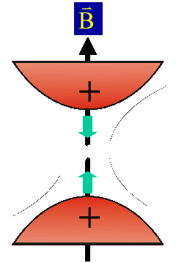



CPT Vital Statistics
B | 5.9 T
r_{o} | 1.16 cm
z_{o} | 1.00 cm
11/17/2010

Slide 18
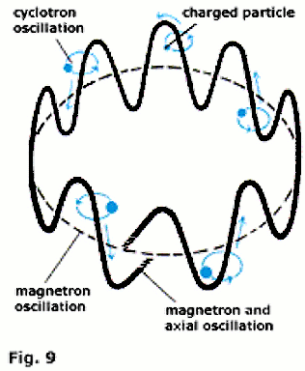
Motion in Trap
MCP
TOF
Detection
Linear
Energy
Magnetic field lines outside the Penning trap
Orbital
Energy
Ions from the Penning trap
11/17/2010

Slide 19
Sample Time of Flight (TOF) Spectra
Calibration: C₅ H₈
FWHM ~ 5 Hz
11/17/2010

Slide 20
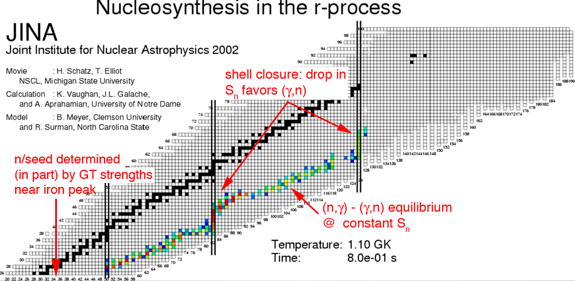
What Masses?

Slide 21
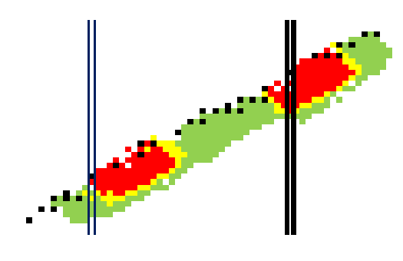
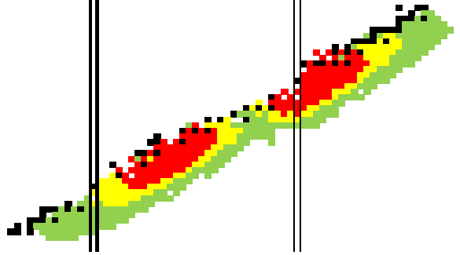
From Where Do We Get The Masses?
²³⁸U
²⁵²Cf

Slide 22
²⁵²Cf
λ = 2.645 years
BR
96.91% α
3.09% SF
Efficiency may be important.

Slide 23
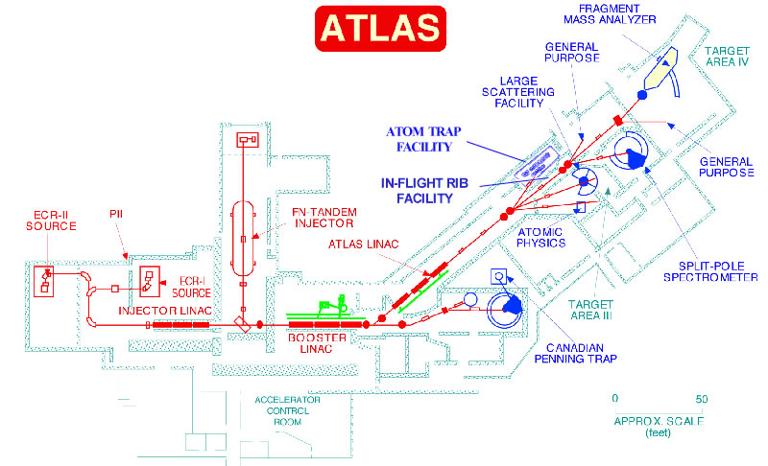
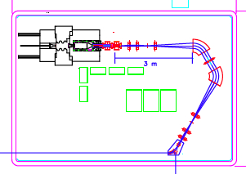
CARIBU

Slide 24
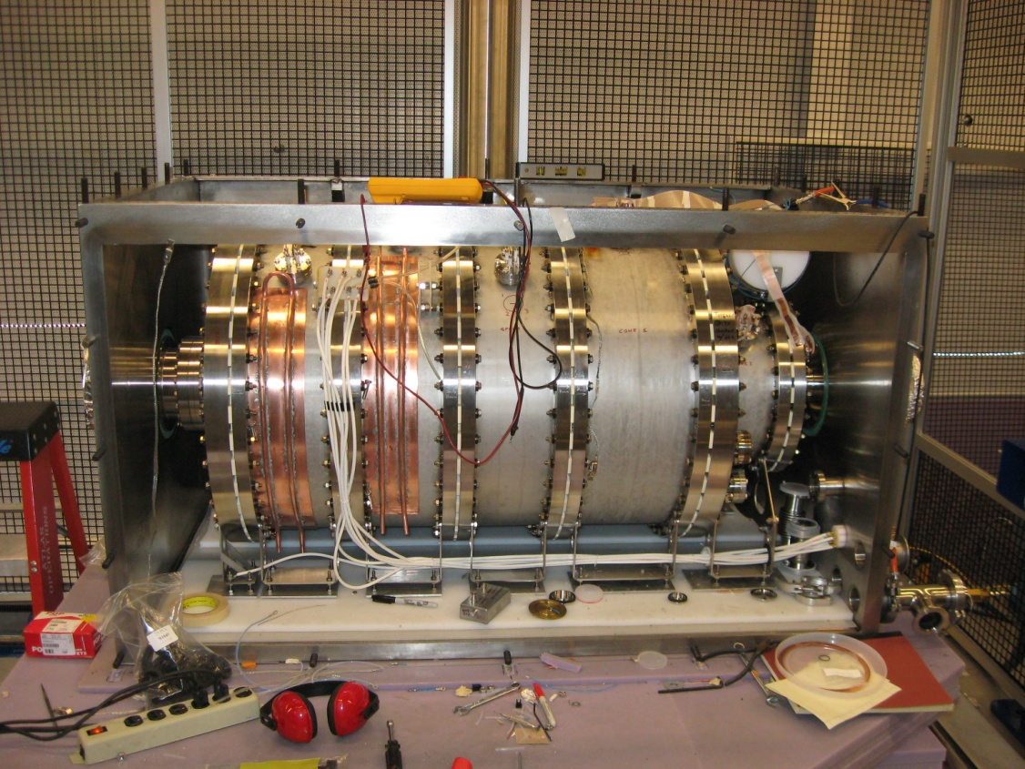
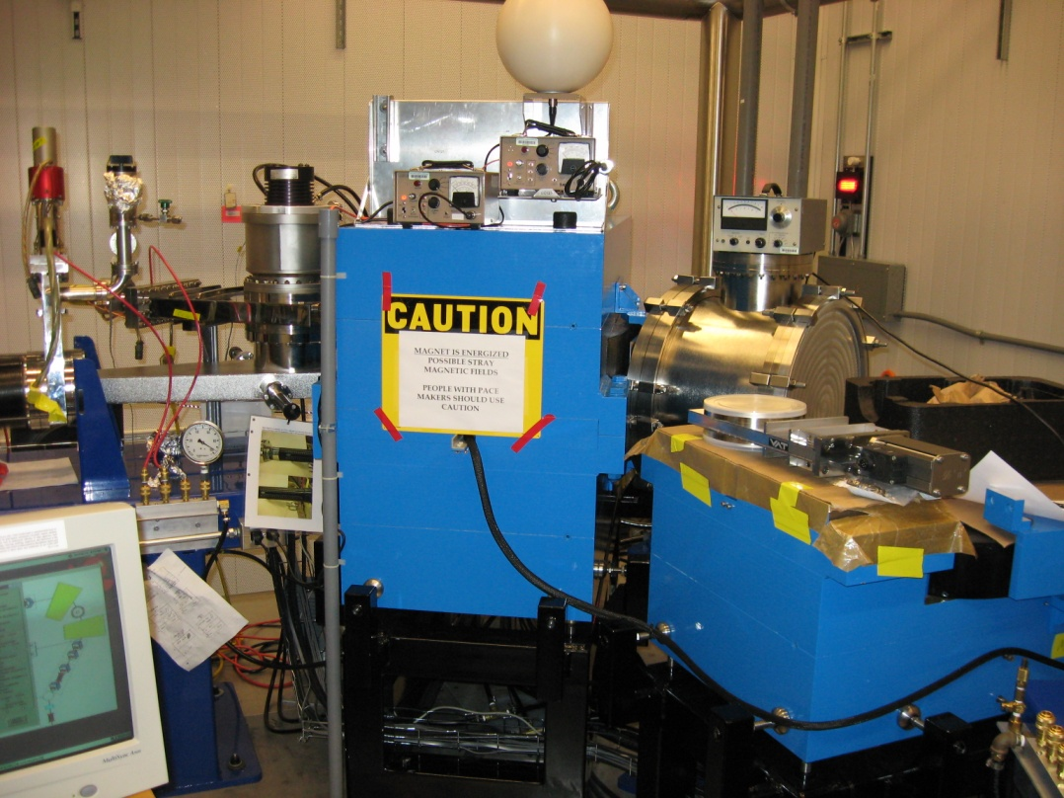
CARIBU
Larger Source (1 Ci)
Larger Acceptance
196,000 cm³ Volume
In-flight isobaric separation
R~20,000
ΔE ± 10 eV

Slide 25
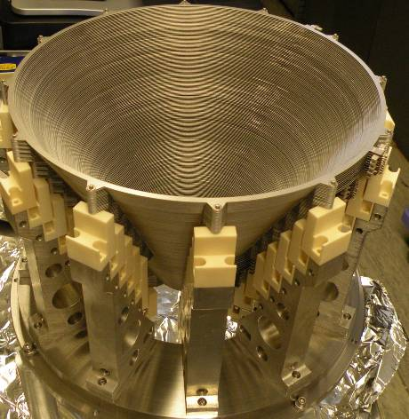
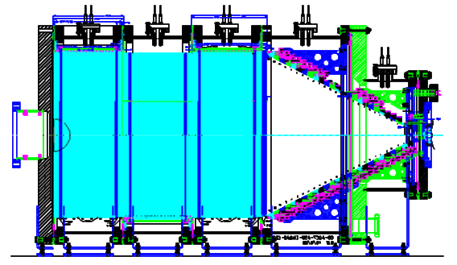
CARIBU gas catcher: transforms fission recoils into a beam with good optical properties
Device similar to ANL RIA/FRIB gas catcher prototype
Radioactive ion transport by RF + DC + gas flow
Stainless steel and ceramics construction
Similar length
Twice the diameter (50 cm inner diameter)
Extraction in 2 RFQ sections with μRFQs
²⁵²Cf
DC gradient
RF (body)
He gas
RF (cone)
To RFQ cooler

Slide 26
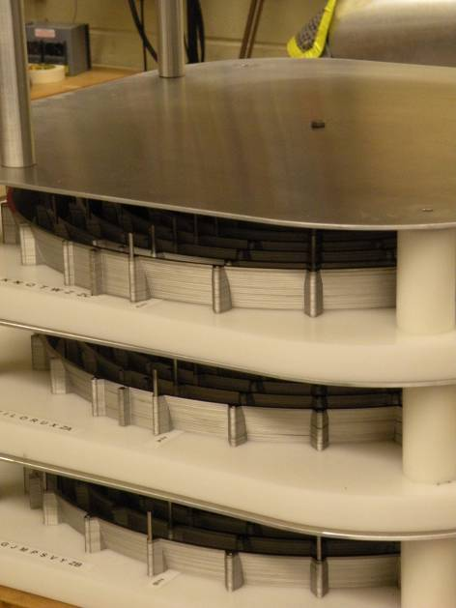
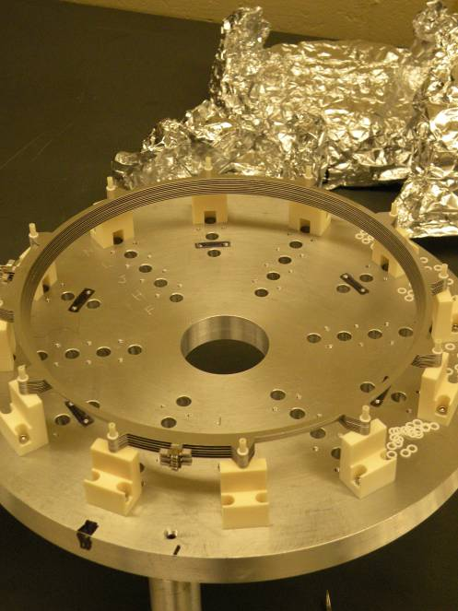
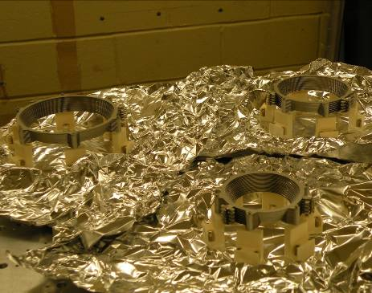
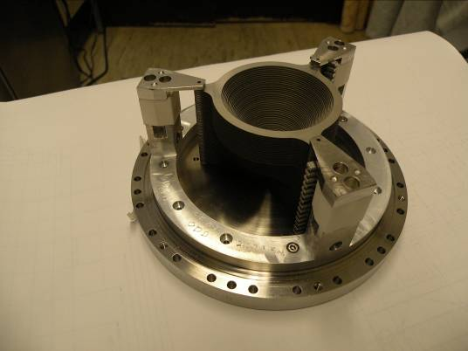
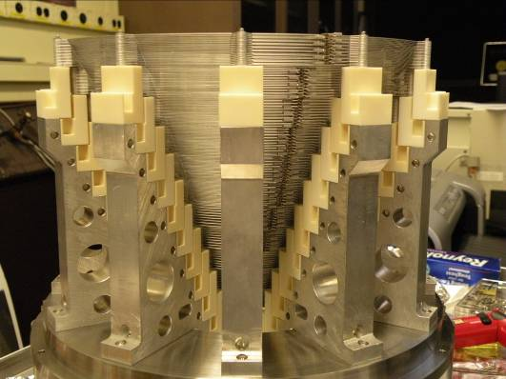
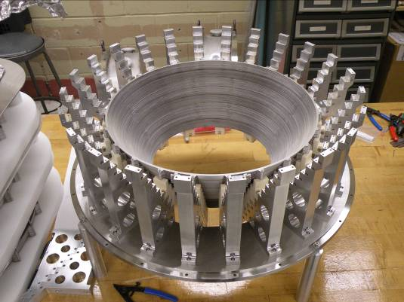
CARIBU Gas Catcher RF Cone preparation

Slide 27
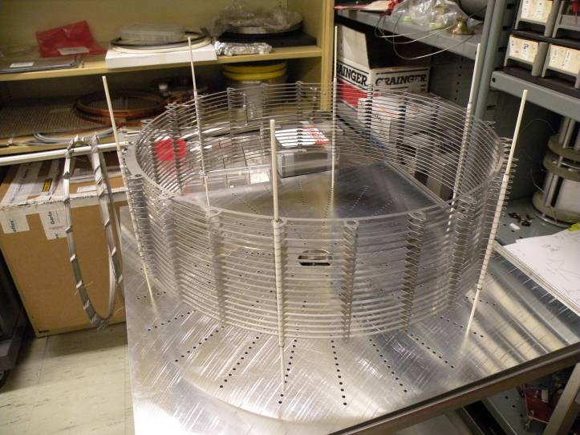
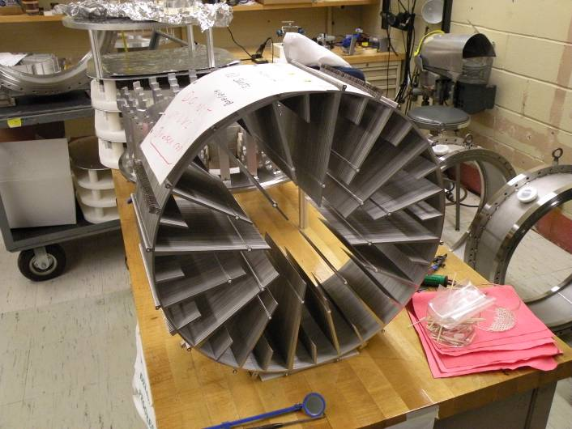
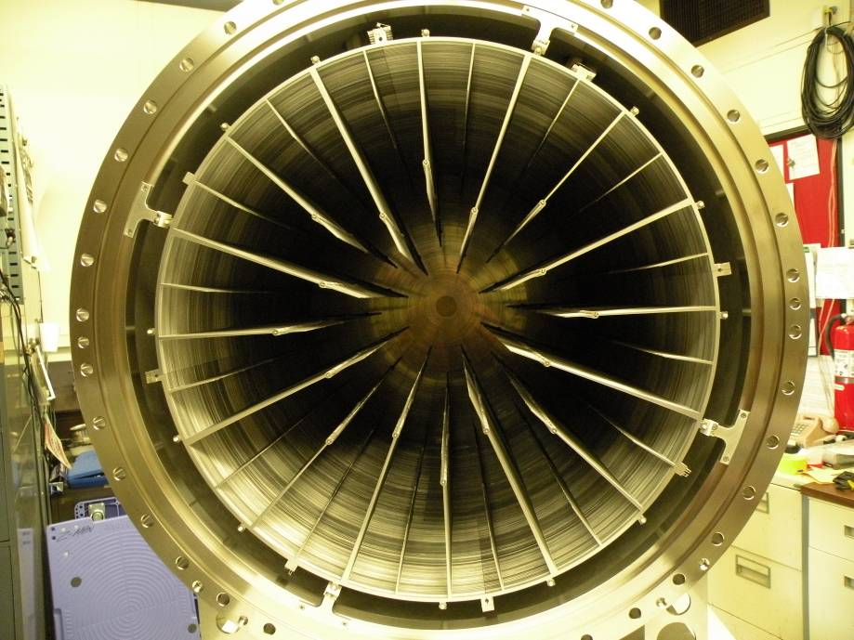
CARIBU gas catcher body sections

Slide 28
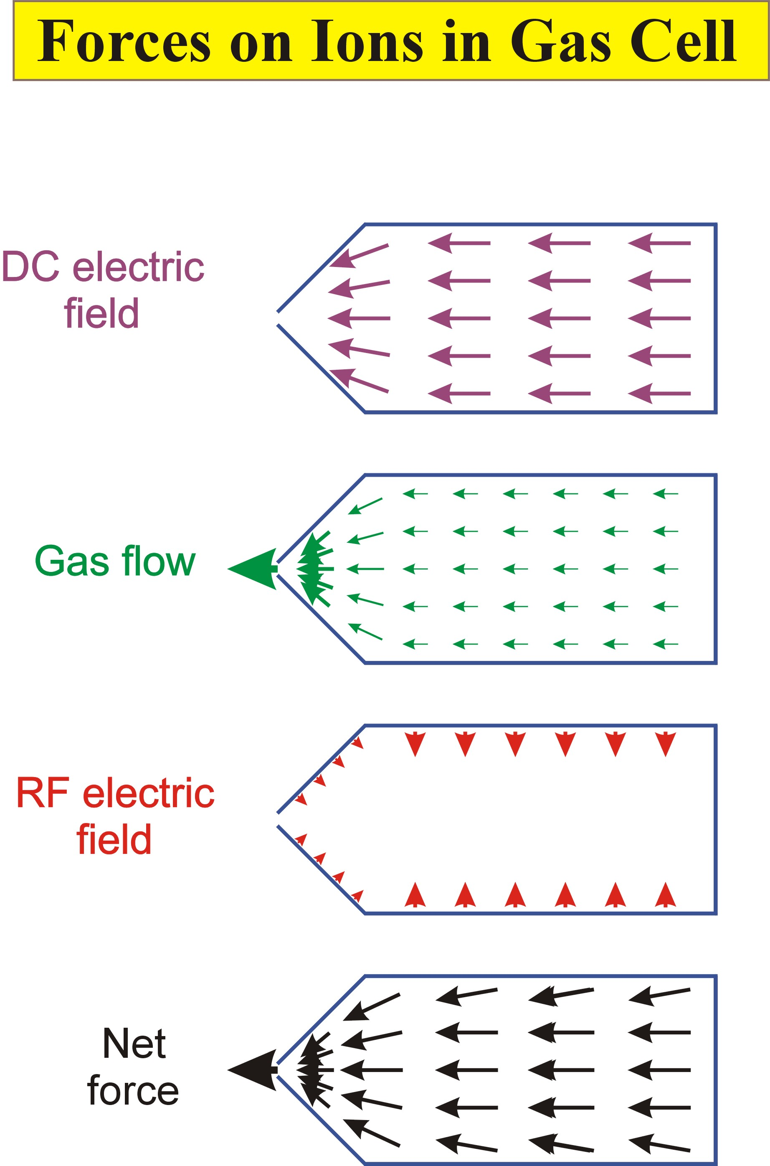

Slide 29
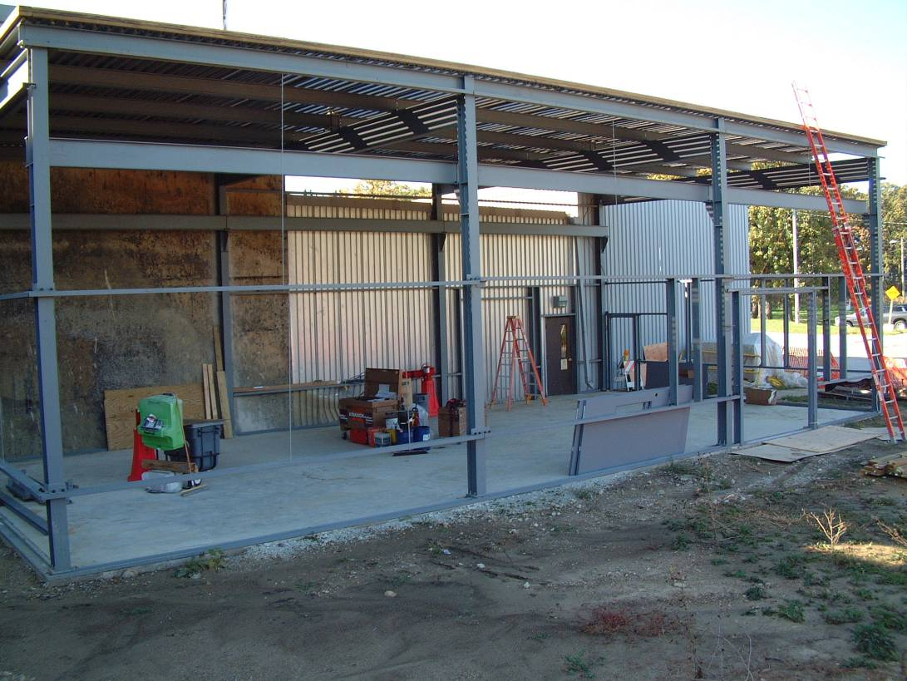
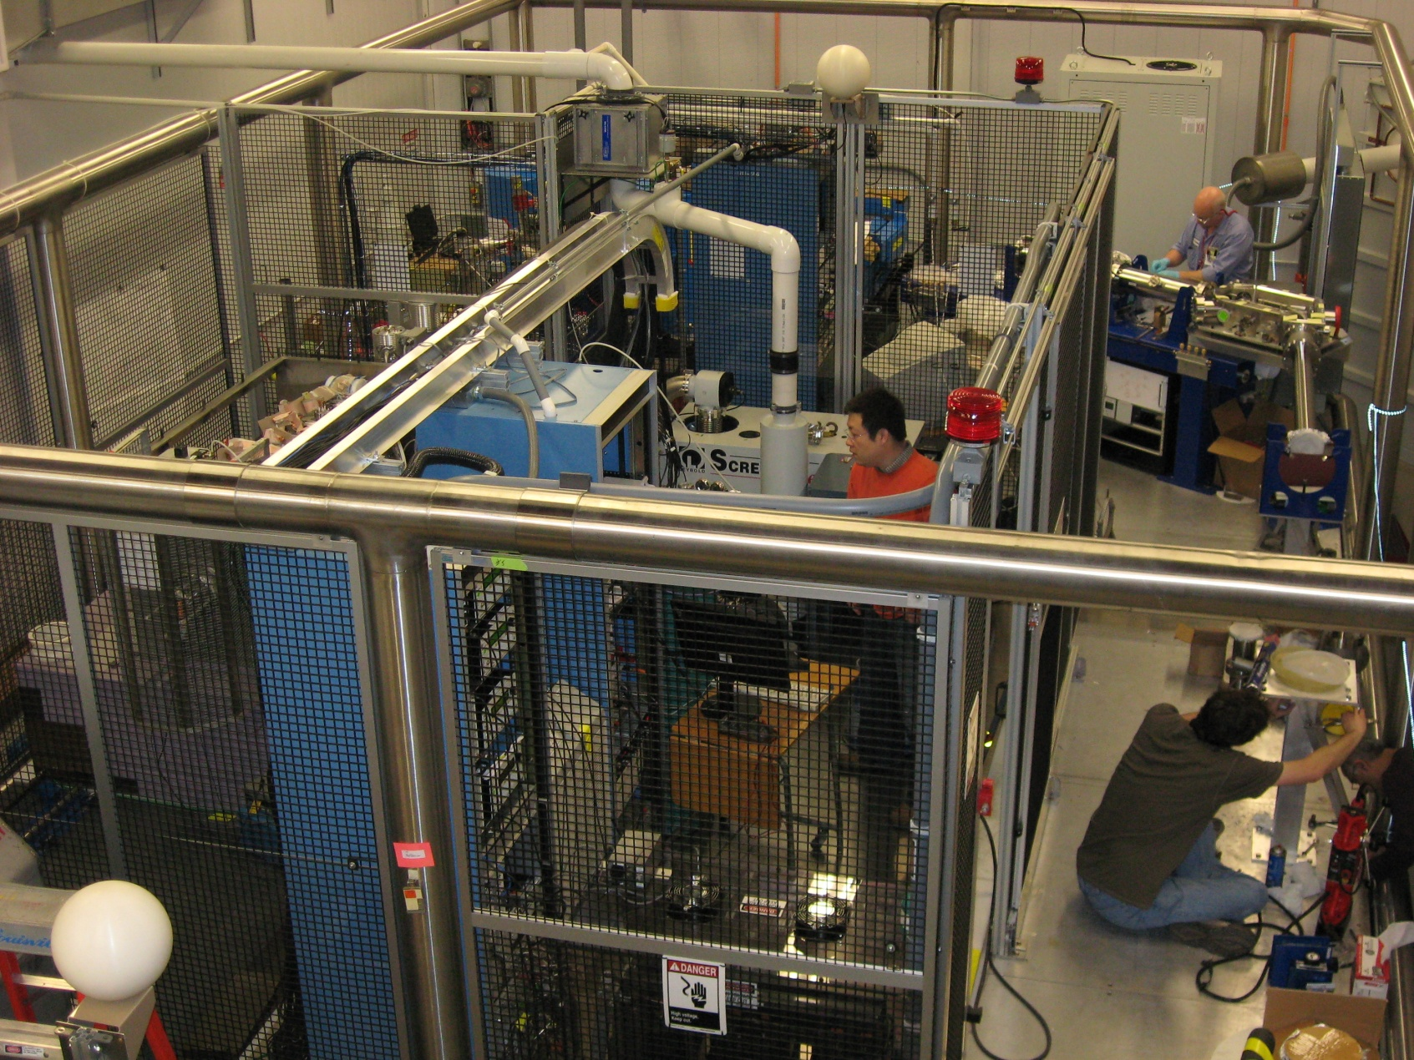
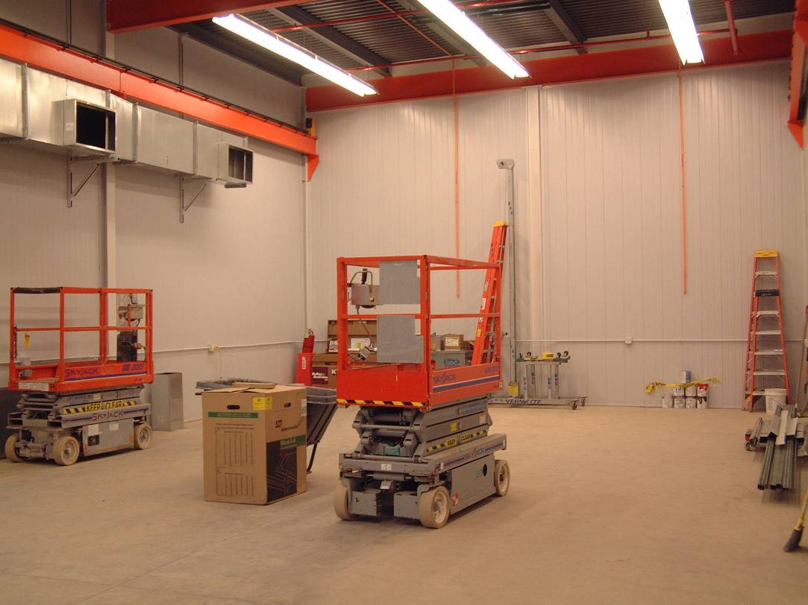
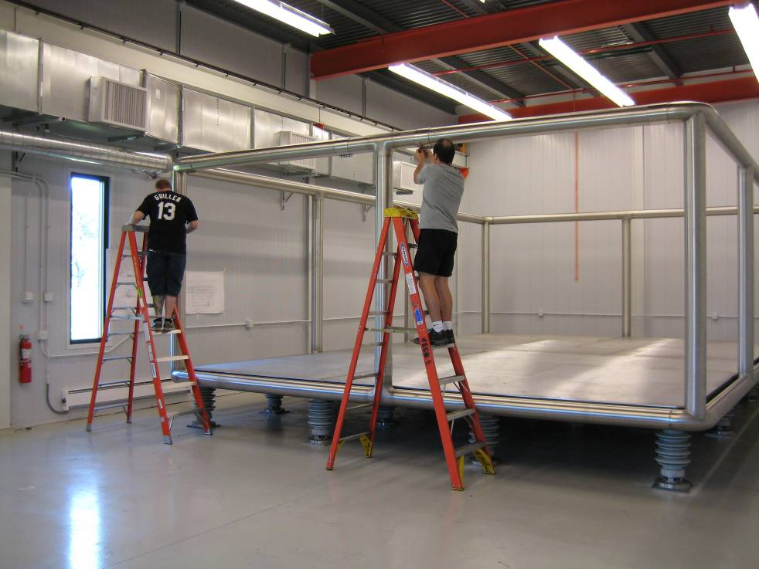
New CARIBU building addition

Slide 30
Neutron-rich beam source: CARIBU “front end” layout
Main components of CARIBU
“ion source” is ²⁵²Cf source inside gas catcher / RFQ cooler
Thermalizes fission fragments
Extracts all species quickly
Forms low emittance beam
Isobar separator
Purifies beam
Charge breeder
Increases charge state for post-acceleration
Post-accelerator
ATLAS with energy upgrade

Slide 31
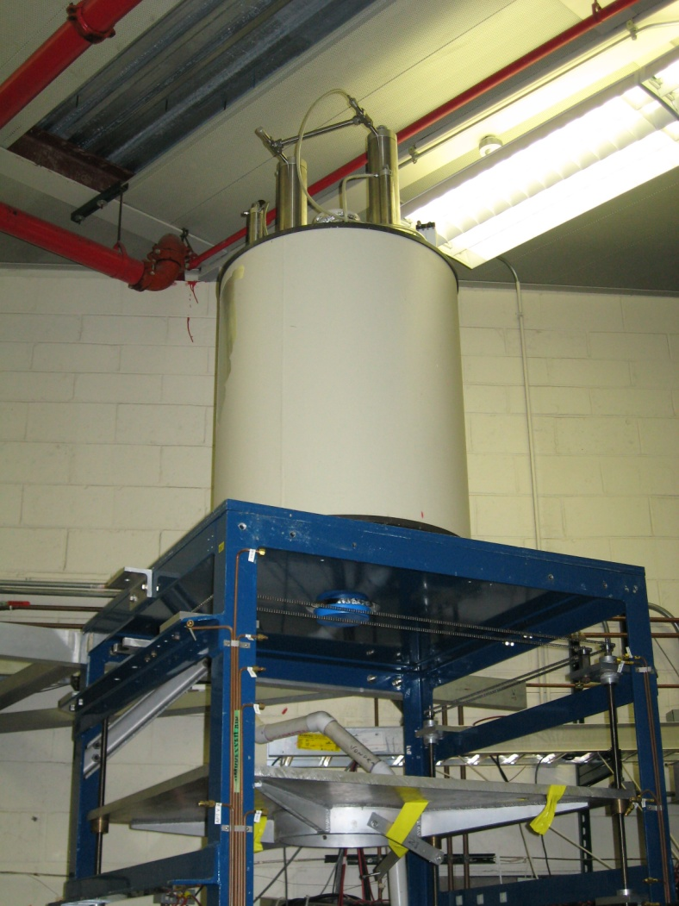
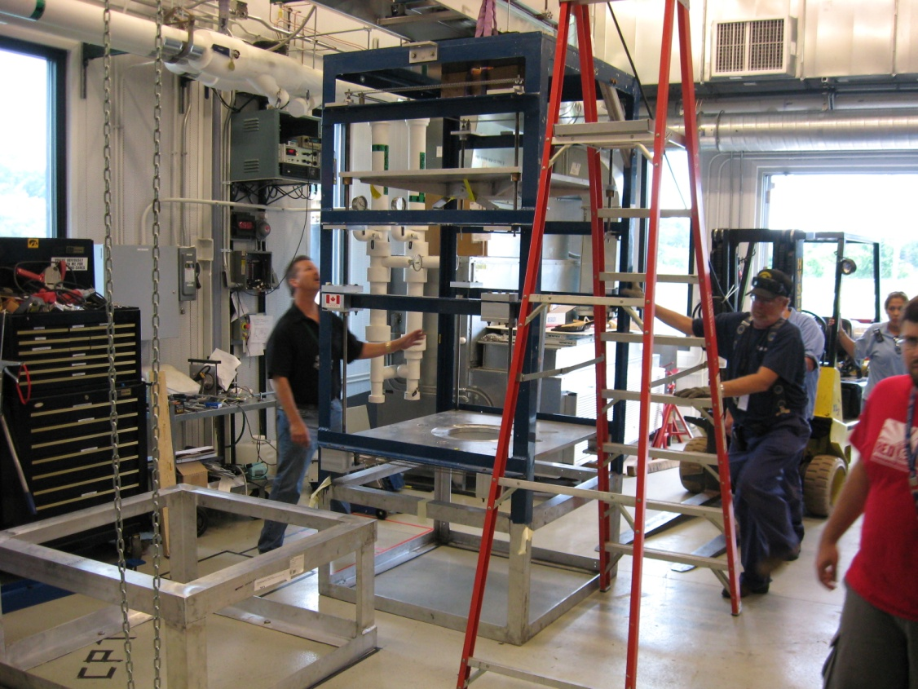
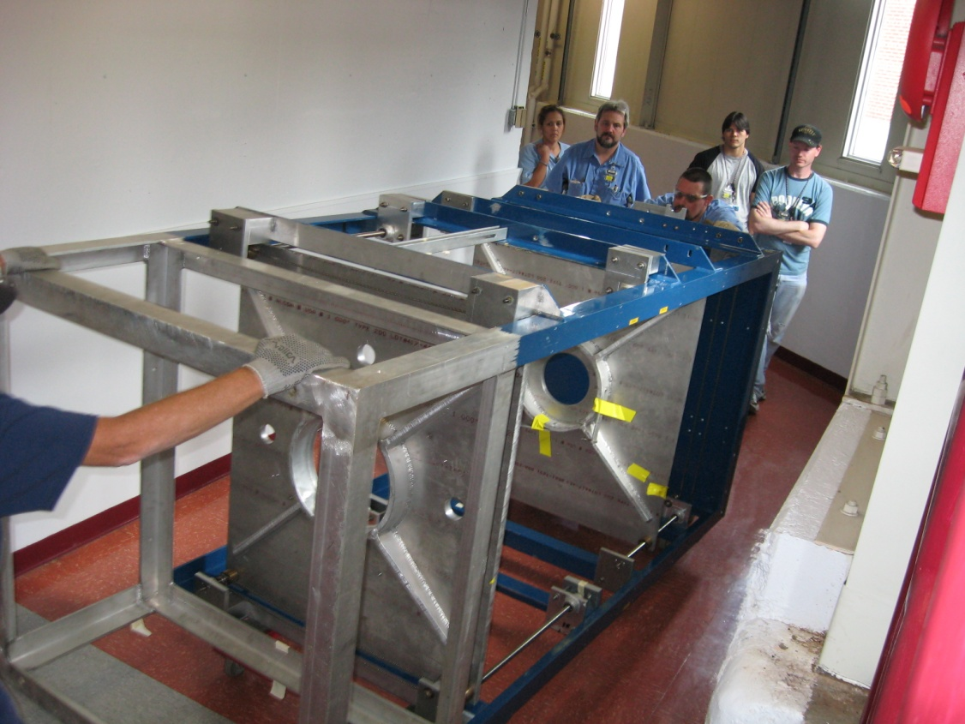
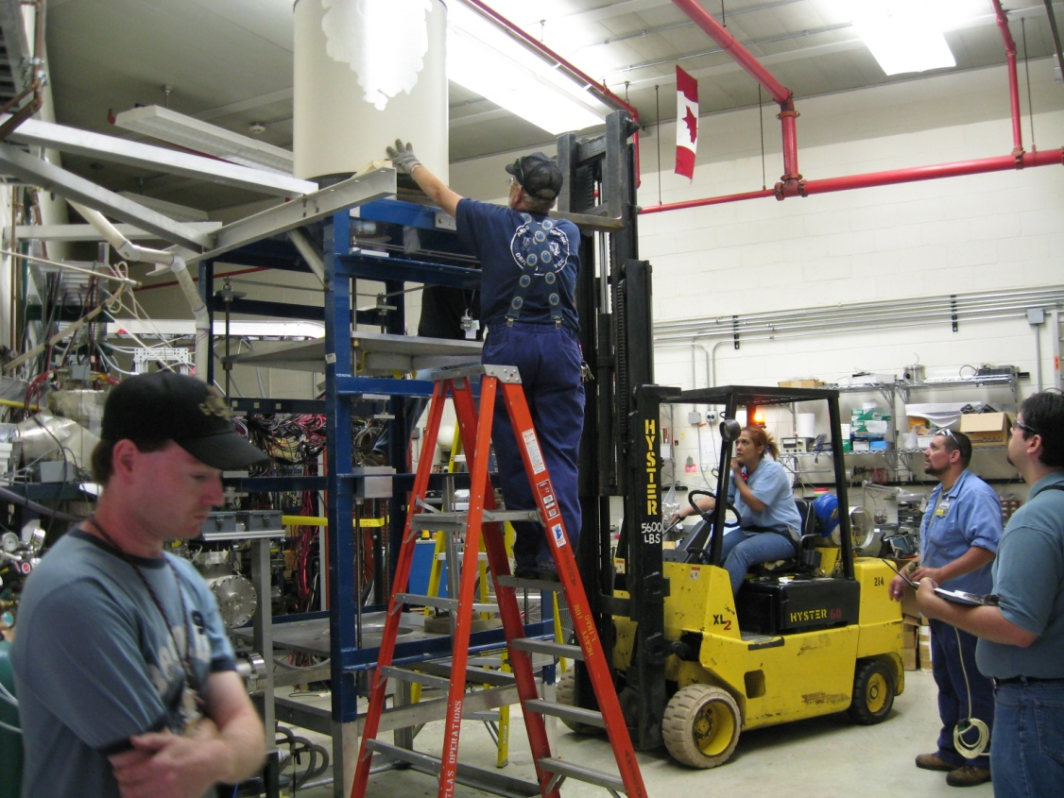
The Move to CARIBU
Removing all components of the tower.
Removing the Magnet
Moving it all.
Putting it up in CARIBU

Slide 32
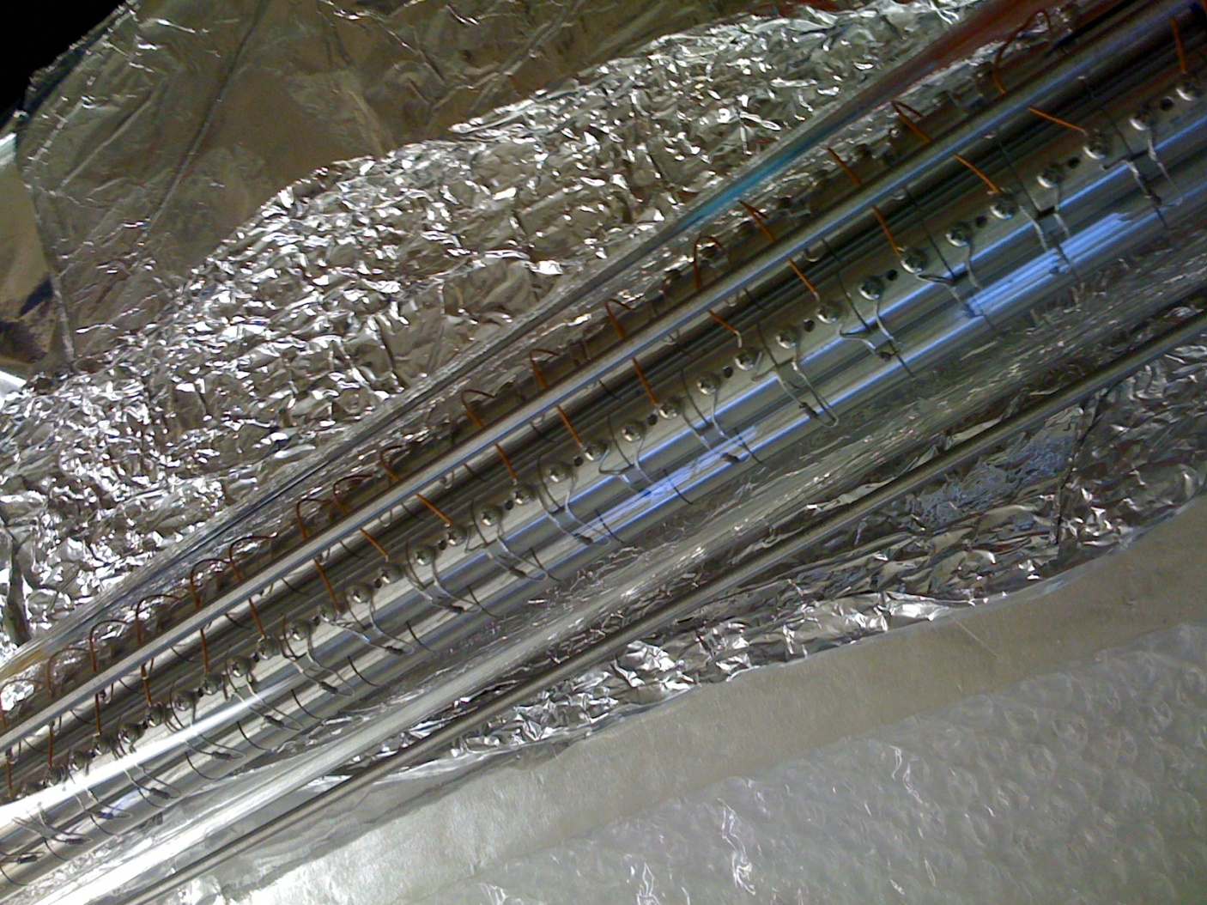
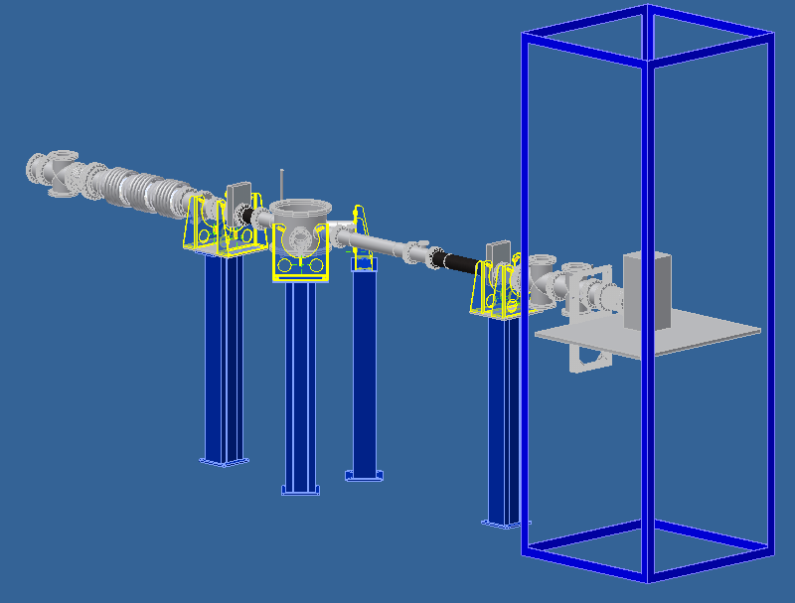
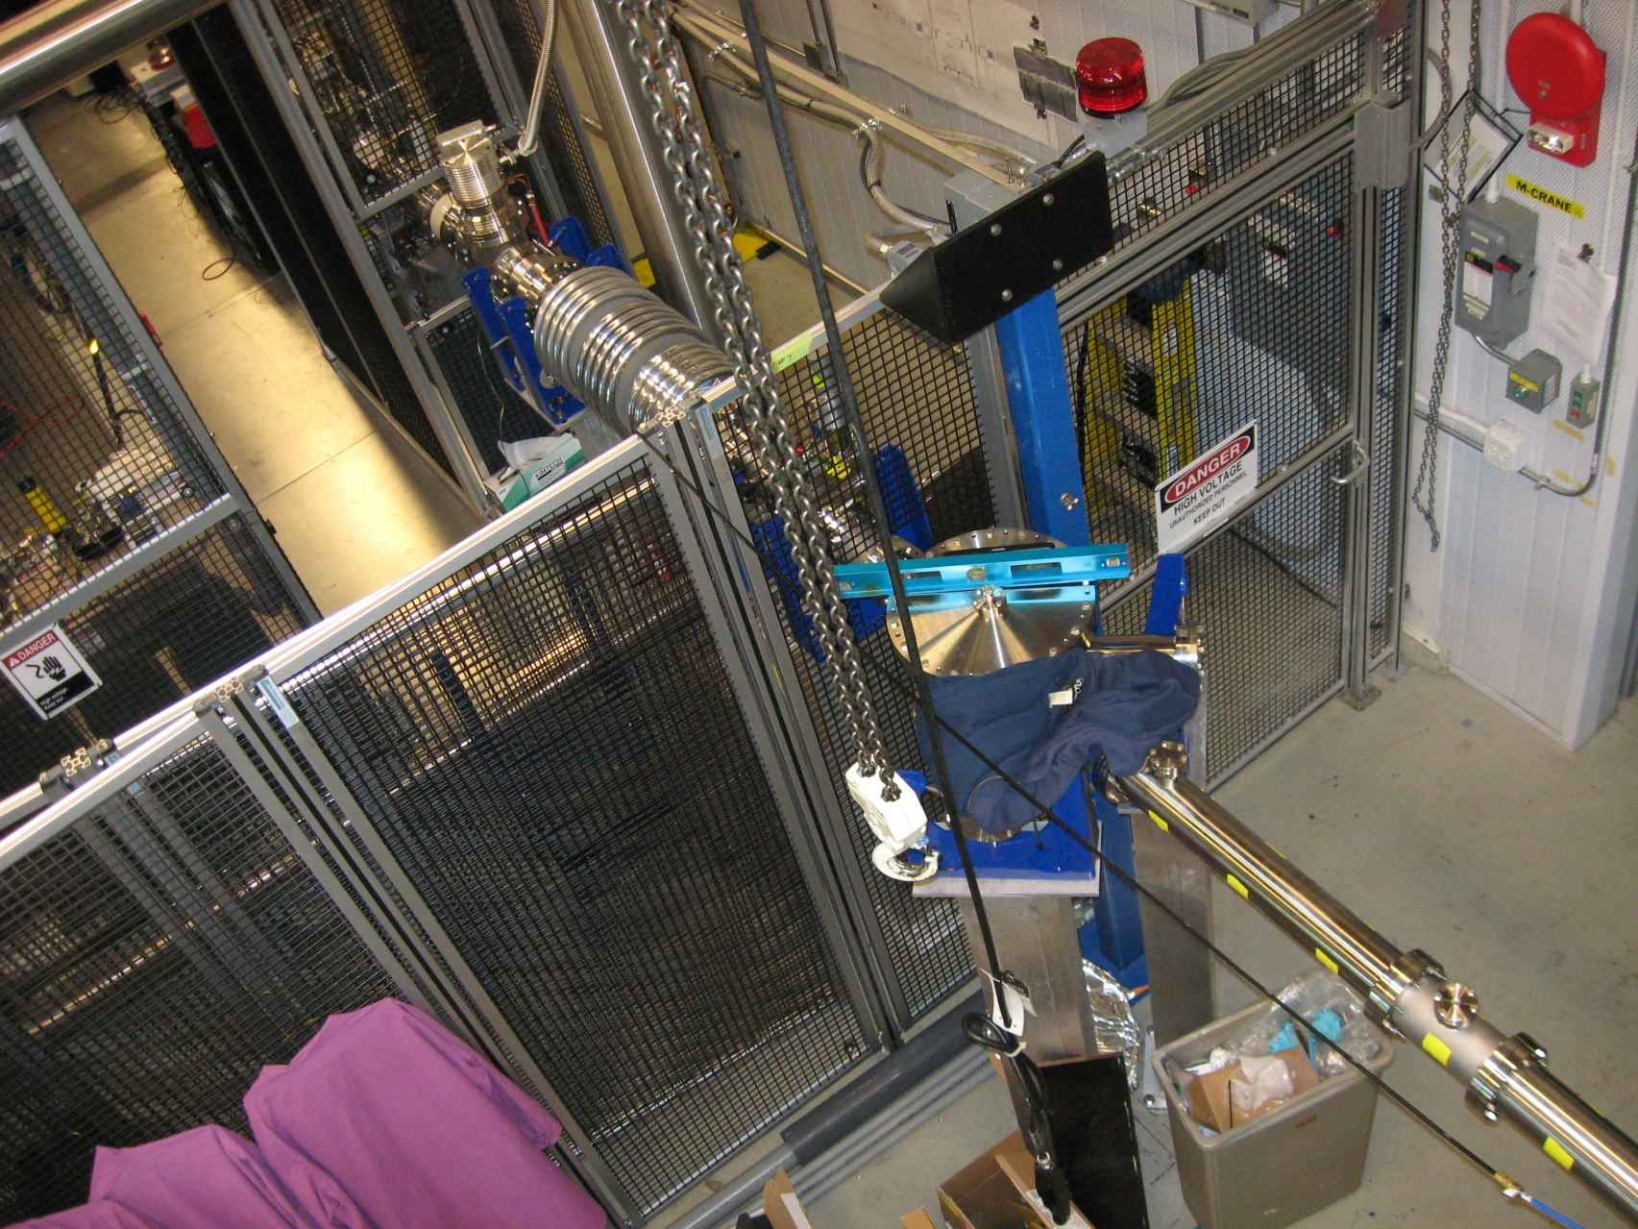
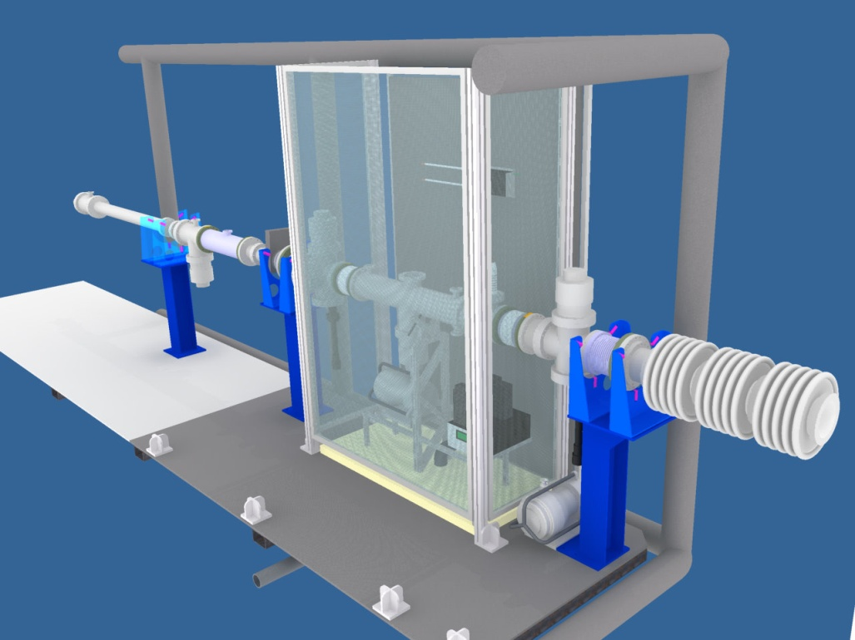
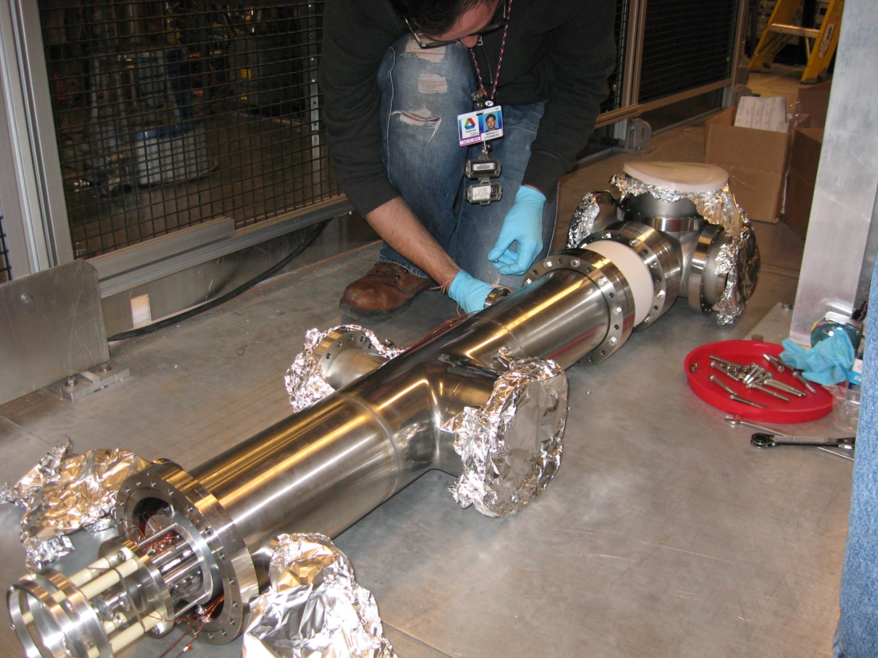



Low Energy Beamline Design
Multiple electrostatic elements to design and assemble
All coming off an HV platform
Gas Cell and RFQ buncher @ 50 kV
Elevator required in order to bring the ions to “off platform” potentials.

Slide 33
What’s Next?
We’re starting to move ²⁵²Cf fission fragments through the RFQ
Concurrently, we’re moving stable ions through the CPT tower and into the trap.
We’ll begin by concentrating on masses in and around the N=82 mass peak
We’ll continue by expanding around the light mass peak of ²⁵²Cf
Measure around N=50.
Change degraders for a campaign on the heavy mass peak.

Slide 34





Slide 35







CPT Collaboration
G. Savard, A. Chaudhuri, J.A. Clark, C. Deibel J.P. Greene, A.F. Levand, T. Sun, B.J. Zabransky,
Argonne National Laboratory
S. Caldwell, M. Sternberg, J. Van Schelt
D. Lascar, R. Segel
J. Fallis, K.S. Sharma
N.D. Scielzo, R. Yee
F. Buchinger, J.E. Crawford, S. Gulick, Gang Li

